Slide 1
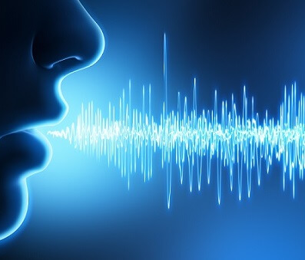


Questions Similarities (Quora Challenge)
Abdelhak NEZZARI
Notes:
Welcome to my presentation, I’m Abdelhak NEZZARI from SAP, I will present my data science project, in which I studied the questions similarities using ‘Quora data set’,

Slide 2
Agenda:
Quora challenge
How to proceed?
Data exploration on original data set
Data cleaning
Features engineering and features extraction
Words statistics
Grammatical entities statistics
Grammatical entities and Words sequences
Cosine distances and similarity matrix
Similarity distances using: DTM, TFIDF and LSA
Apply Machine learning models to calculated Features
Deep Learning
Auto-encoders
Classifiers
Demo Shiny application
Notes:
The agenda will be:
I will start by saying something about Quora and its challenge
Then, how to proceed and solve it
I will present some data exploration on the original data set
Then, data cleaning
After, I will talk about features extractions from the sentences of the questions
Features like:
..
I will apply some machine learning models on the calculated features
I will continue with another alternative which does not need to calculated, I will use deep learning using Keras library,
I will not talk about autoencoders which are part of my project,
At the end, if there are remaining time, I will show you a Shiny application where I tried to integrate some parts of the project

Slide 3
Agenda:
Quora challenge
How to proceed?
Data exploration on original data set
Data cleaning
Features engineering and features extraction
Words statistics
Grammatical entities statistics
Grammatical entities and Words sequences
Cosine distances and similarity matrix
Similarity distances using: DTM, TFIDF and LSA
Apply Machine learning models to calculated Features
Deep Learning
Auto-encoders
Classifiers
Demo Shiny application
Notes:
The agenda will be:
I will start by saying something about Quora and its challenge
Then, how to proceed and solve it
I will present some data exploration on the original data set
Then, data cleaning
After, I will talk about features extractions from the sentences of the questions
Features like:
..
I will apply some machine learning models on the calculated features
I will continue with another alternative which does not need to calculated, I will use deep learning using Keras library,
I will not talk about autoencoders which are part of my project,
At the end, if there are remaining time, I will show you a Shiny application where I tried to integrate some parts of the project

Slide 4


Quora Challenge: Question Similarities
Quora is place and platform to:
Ask questions
Share knowledge about every thing
Empower people learning from each other
100 million of people visiting Quora per month.
They ask similarly worded questions, this can cause:
Seekers spends more time in searching the best answer
Make writers feel they need to answer multiple versions of same question
4

Slide 5
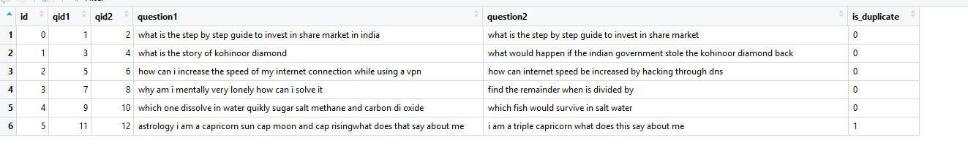
Data set:
Data Consist of ‘404 290’ pair of questions:
The challenge consists of predicting the duplicate questions
Notes:
Quora offered data set which consist of 404 290 Pair of questions, and the challenge consist of predicting the duplicated questions
The data set look as shown here, it has mainly three columns: question1, question2 and the ‘is_duplicate’ columns which tell if the question1 and question2 are duplicate or not

Slide 6
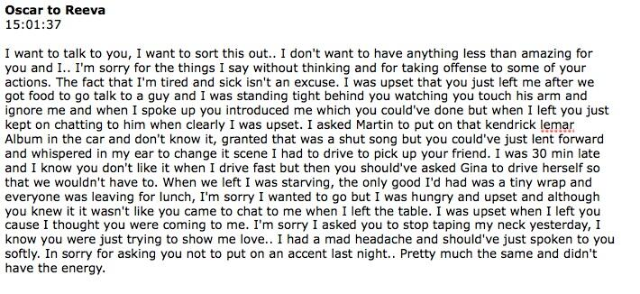
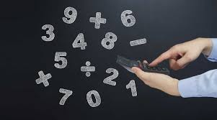
Questions & Hypothesis:
How to drive a data science project given the data we have which conist of pair of questions
What kind of meaningful information we can extract from the two pair of question that can help in our prediction

Slide 7
Agenda:
Quora challenge
How to proceed?
Data exploration on original data set
Data cleaning
Features engineering and features extraction
Words statistics
Grammatical entities statistics
Grammatical entities and Words sequences
Cosine distances and similarity matrix
Similarity distances using: DTM, TFIDF and LSA
Apply Machine learning models to calculated Features
Deep Learning
Auto-encoders
Classifiers
Demo Shiny application
Notes:
The agenda will be:
I will start by saying something about Quora and its challenge
Then, how to proceed and solve it
I will present some data exploration on the original data set
Then, data cleaning
After, I will talk about features extractions from the sentences of the questions
Features like:
..
I will apply some machine learning models on the calculated features
I will continue with another alternative which does not need to calculated, I will use deep learning using Keras library,
I will not talk about autoencoders which are part of my project,
At the end, if there are remaining time, I will show you a Shiny application where I tried to integrate some parts of the project

Slide 8
How to proceed?
Feature engineering and machine learning
Deep learning
Transform the pair of questions to matrixes
Calculate features
Use machine learning to predict
Transform the pair of questions to matrixes
Use deep learning to predict
Notes:
We have followed two approaches:
Feature engineering and machine learning
On the other hand deep learning
In the first approach we will calculate numerical values which we call features, and we use them in machine learning model to predict the duplicability
In the second approach we use deep learning layers of neural network, that we feed by two questions, after vectorizing the words in every question

Slide 9
Agenda:
Quora challenge
How to proceed?
Data exploration on original data set
Data cleaning
Features engineering and features extraction
Words statistics
Grammatical entities statistics
Grammatical entities and Words sequences
Cosine distances and similarity matrix
Similarity distances using: DTM, TFIDF and LSA
Apply Machine learning models to calculated Features
Deep Learning
Auto-encoders
Classifiers
Demo Shiny application
Notes:
The agenda will be:
I will start by saying something about Quora and its challenge
Then, how to proceed and solve it
I will present some data exploration on the original data set
Then, data cleaning
After, I will talk about features extractions from the sentences of the questions
Features like:
..
I will apply some machine learning models on the calculated features
I will continue with another alternative which does not need to calculated, I will use deep learning using Keras library,
I will not talk about autoencoders which are part of my project,
At the end, if there are remaining time, I will show you a Shiny application where I tried to integrate some parts of the project

Slide 10
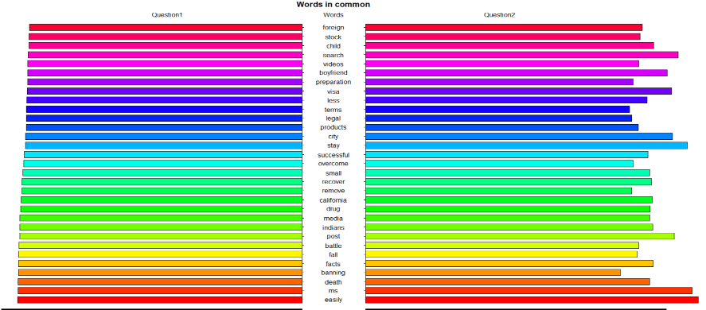
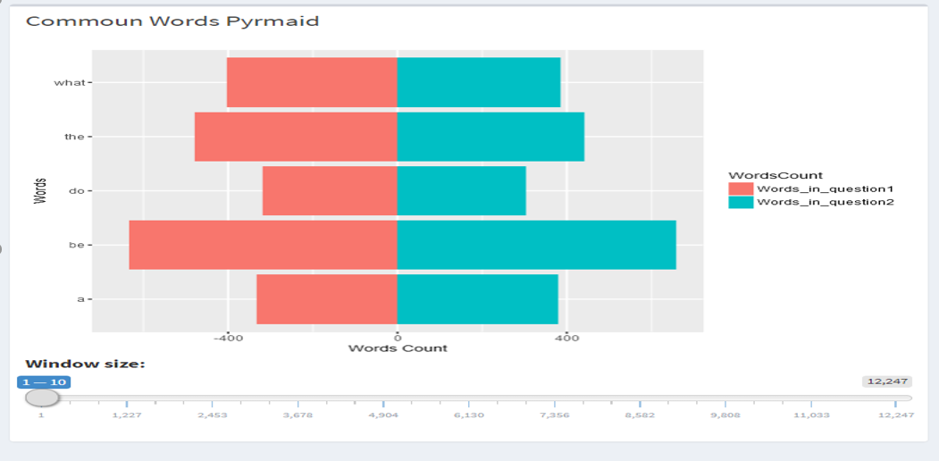
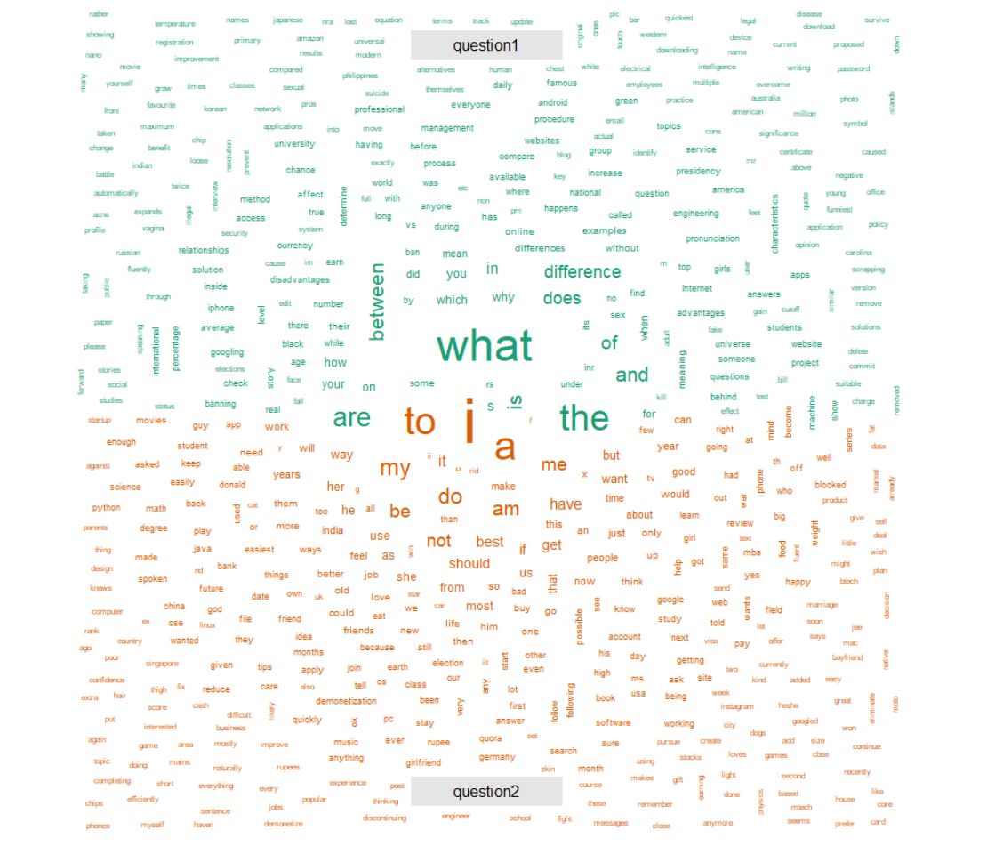
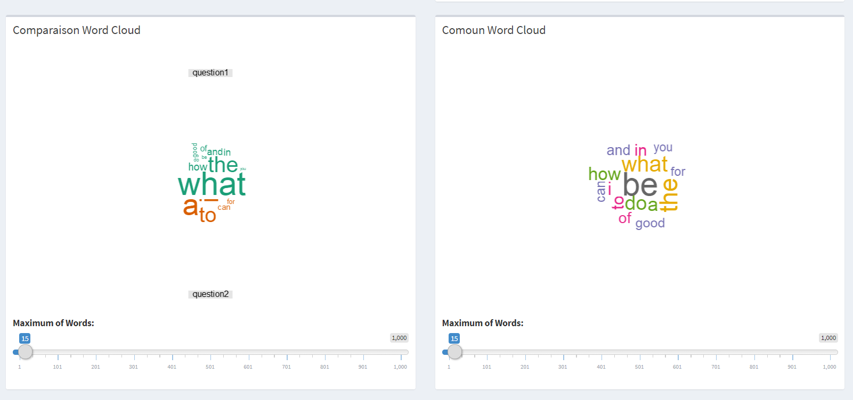
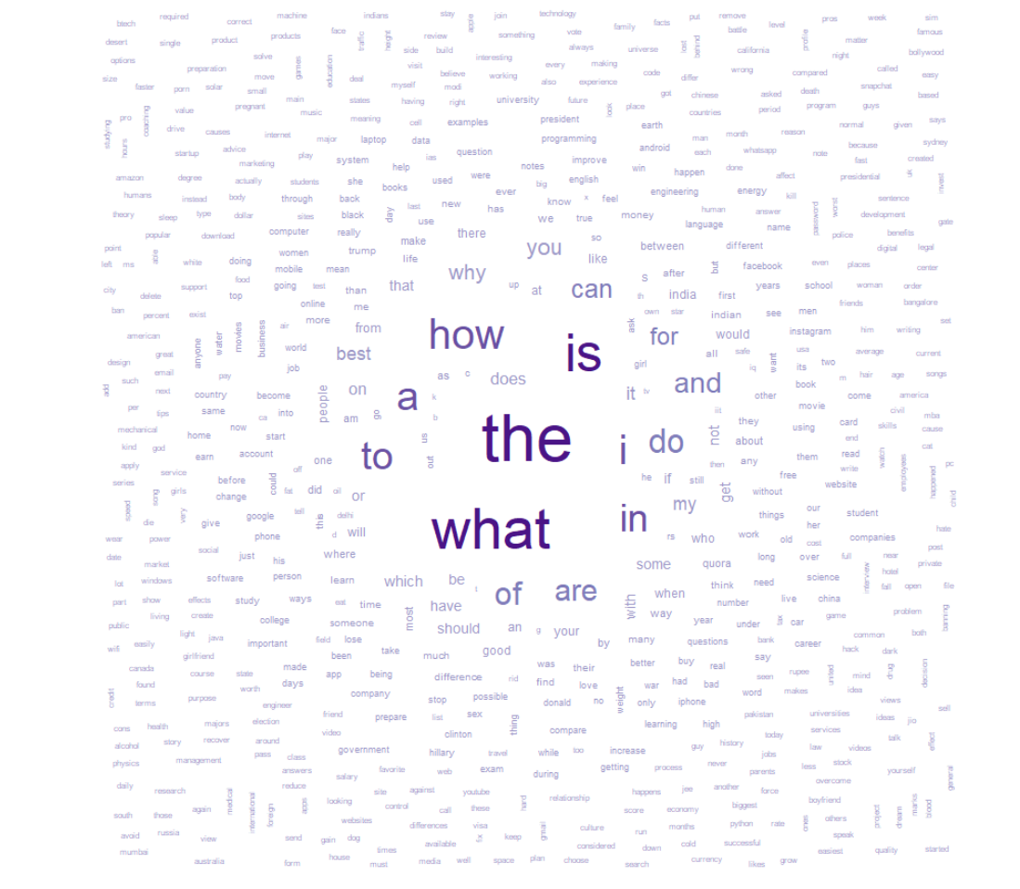
Data exploration on original data set:
Data is pairs of two document corpus.
Comparison of words in two text corpus:
Word pyramid
Word Cloud comparison
Common words Word Cloud:
Notes:
We show first some graphics which are based on words statistics of the original data set.
We get all the words from the two columns of our data set: Question1 and Question2, after this we compare the two columns text corpus using:
Word pyramid , world cloud
We have implemented a shiny version where the user can use sliders to control the number of words that can be shown in:
word cloud or in word pyramid

Slide 11
Agenda:
Quora challenge
How to proceed?
Data exploration on original data set
Data cleaning
Features engineering and features extraction
Words statistics
Grammatical entities statistics
Grammatical entities and Words sequences
Cosine distances and similarity matrix
Similarity distances using: DTM, TFIDF and LSA
Apply Machine learning models to calculated Features
Deep Learning
Auto-encoders
Classifiers
Demo Shiny application
Notes:
The agenda will be:
I will start by saying something about Quora and its challenge
Then, how to proceed and solve it
I will present some data exploration on the original data set
Then, data cleaning
After, I will talk about features extractions from the sentences of the questions
Features like:
..
I will apply some machine learning models on the calculated features
I will continue with another alternative which does not need to calculated, I will use deep learning using Keras library,
I will not talk about autoencoders which are part of my project,
At the end, if there are remaining time, I will show you a Shiny application where I tried to integrate some parts of the project

Slide 12
Data Cleaning
tolower(): I like -> i like
split_non_ascii(): 形から入る -> 形 か ら 入 る
replace_appostrophs(): what's -> what is, isn’t -> is not
remove_brackets(): "spiritual" -> spiritual
remove_punctuations(): . ?
Keep as much as possible of words
12
Notes:
To prepare the data to the next step, we need to clean the word vocabulary in the data set, the different steps are mentioned here:
Convert all letters of words to lower case, so that we have uniformed way of writing the words
Introduce a space between the non-ascii characters, as every character is a word,
Replace apostrophes , remove brackets and punctuations.
Important thing to mention, is that we are keeping as much as possible of the words, as we are dealing with the semantics

Slide 13
Agenda:
Quora challenge
How to proceed?
Data exploration on original data set
Data cleaning
Features engineering and features extraction
Words statistics
Grammatical entities statistics
Grammatical entities and Words sequences
Cosine distances and similarity matrix
Similarity distances using: DTM, TFIDF and LSA
Apply Machine learning models to calculated Features
Deep Learning
Auto-encoders
Classifiers
Demo Shiny application
Notes:
The agenda will be:
I will start by saying something about Quora and its challenge
Then, how to proceed and solve it
I will present some data exploration on the original data set
Then, data cleaning
After, I will talk about features extractions from the sentences of the questions
Features like:
..
I will apply some machine learning models on the calculated features
I will continue with another alternative which does not need to calculated, I will use deep learning using Keras library,
I will not talk about autoencoders which are part of my project,
At the end, if there are remaining time, I will show you a Shiny application where I tried to integrate some parts of the project

Slide 14
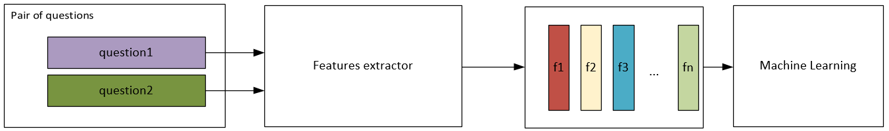
Feature engineering:
Number of words
Grammatical entities
Sequence of grammatical entities and of words
Word vector representation
Cosine distance between two words

Slide 15
Agenda:
Quora challenge
How to proceed?
Data exploration on original data set
Data cleaning
Features engineering and features extraction
Words statistics
Grammatical entities statistics
Grammatical entities and Words sequences
Cosine distances and similarity matrix
Similarity distances using: DTM, TFIDF and LSA
Apply Machine learning models to calculated Features
Deep Learning
Auto-encoders
Classifiers
Demo Shiny application
Notes:
The agenda will be:
I will start by saying something about Quora and its challenge
Then, how to proceed and solve it
I will present some data exploration on the original data set
Then, data cleaning
After, I will talk about features extractions from the sentences of the questions
Features like:
..
I will apply some machine learning models on the calculated features
I will continue with another alternative which does not need to calculated, I will use deep learning using Keras library,
I will not talk about autoencoders which are part of my project,
At the end, if there are remaining time, I will show you a Shiny application where I tried to integrate some parts of the project

Slide 16
Feature of words Statistics:
Number of words in sentence
Number of stop words sentence
Number difference words between sentence (1 , 2), and (2,1)
Feature of Grammatical entities Statistics:
NLP ‘Part-of-Speech taggers’
Number of verbs
Number of adjectives
Number of proper nouns
45 entities per one question.
We use PCA and Cosine Distance to reduce the dimensionality

Slide 17
Agenda:
Quora challenge
How to proceed?
Data exploration on original data set
Data cleaning
Features engineering and features extraction
Words statistics
Grammatical entities statistics
Grammatical entities and Words sequences
Cosine distances and similarity matrix
Similarity distances using: DTM, TFIDF and LSA
Apply Machine learning models to calculated Features
Deep Learning
Auto-encoders
Classifiers
Demo Shiny application
Notes:
The agenda will be:
I will start by saying something about Quora and its challenge
Then, how to proceed and solve it
I will present some data exploration on the original data set
Then, data cleaning
After, I will talk about features extractions from the sentences of the questions
Features like:
..
I will apply some machine learning models on the calculated features
I will continue with another alternative which does not need to calculated, I will use deep learning using Keras library,
I will not talk about autoencoders which are part of my project,
At the end, if there are remaining time, I will show you a Shiny application where I tried to integrate some parts of the project

Slide 18
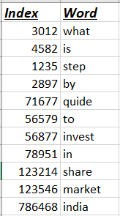
Features of Sequences:
TraminR is library in R used by social scientist to study careers trajectory
seqLLCS: length of the longest common subsequence of two sequences.
seqLLCP: the length of the longest common prefix of two sequences.
1. Sequence Grammatical entities:
We get the sequence of grammatical entities using OpenNLP,
We use the two functions of TraminR to quantify the sequence distances
2. Sequence of words in sentences:
We extract vocabulary used in both questions, and we give an index for every word, Every question will be a sequence of index numbers.
We calculate the distance of sequences of the pair of questions by using TraminR

Slide 19
Agenda:
Quora challenge
How to proceed?
Data exploration on original data set
Data cleaning
Features engineering and features extraction
Words statistics
Grammatical entities statistics
Grammatical entities and Words sequences
Cosine distances and similarity matrix
Similarity distances using: DTM, TFIDF and LSA
Apply Machine learning models to calculated Features
Deep Learning
Auto-encoders
Classifiers
Demo Shiny application
Notes:
The agenda will be:
I will start by saying something about Quora and its challenge
Then, how to proceed and solve it
I will present some data exploration on the original data set
Then, data cleaning
After, I will talk about features extractions from the sentences of the questions
Features like:
..
I will apply some machine learning models on the calculated features
I will continue with another alternative which does not need to calculated, I will use deep learning using Keras library,
I will not talk about autoencoders which are part of my project,
At the end, if there are remaining time, I will show you a Shiny application where I tried to integrate some parts of the project

Slide 20
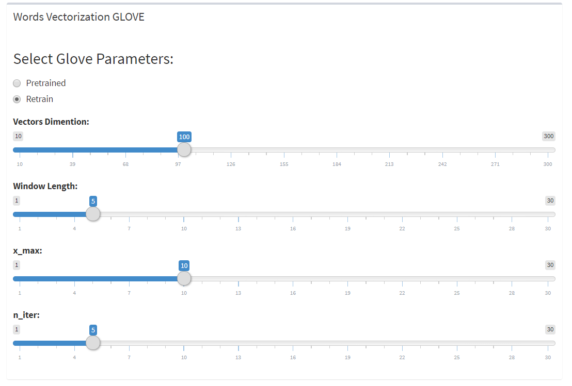
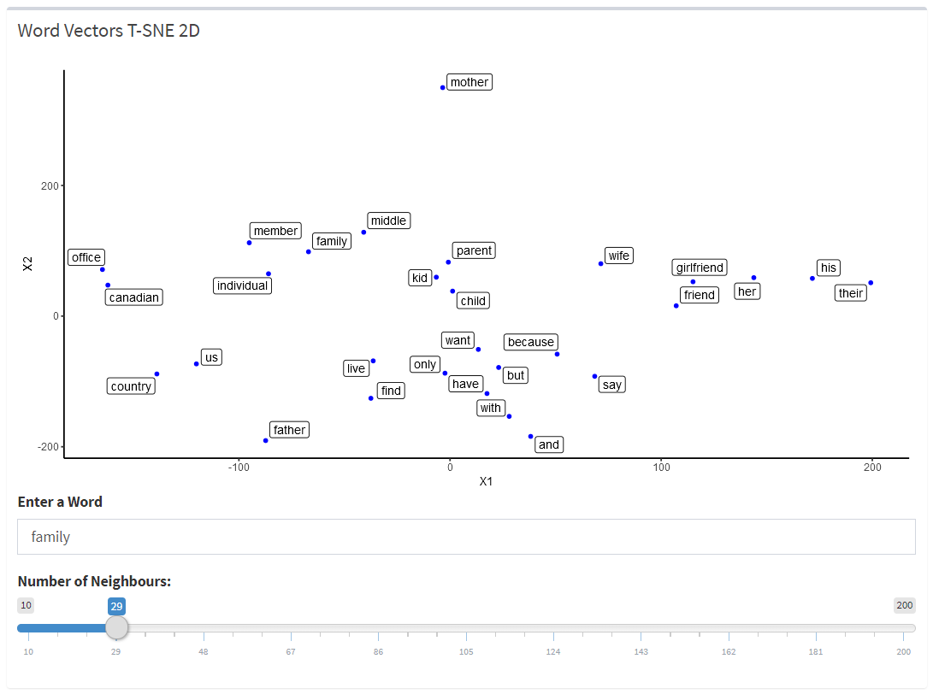
Features based on Word Vectors
Word Vector:
We used Glove (Global vector) Algorithm to generate high dimension vectors for the words
TCM: Term co-occurrence matrix

Slide 21
Matrix of sentence:
Word is Vector
Question sentence is Matrix

Slide 22
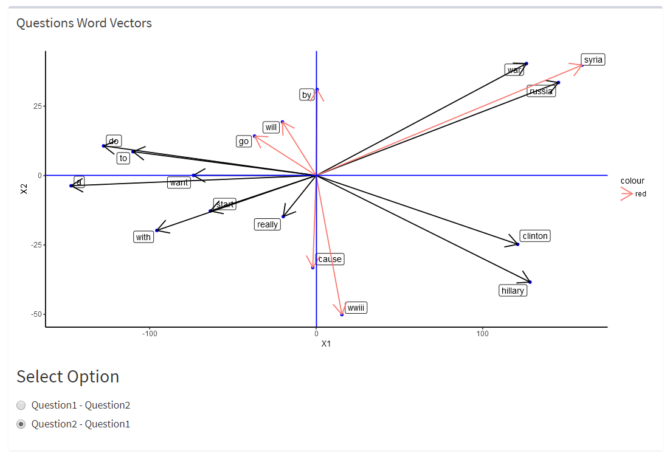
Cosine Distance between words of questions:
22

Slide 23
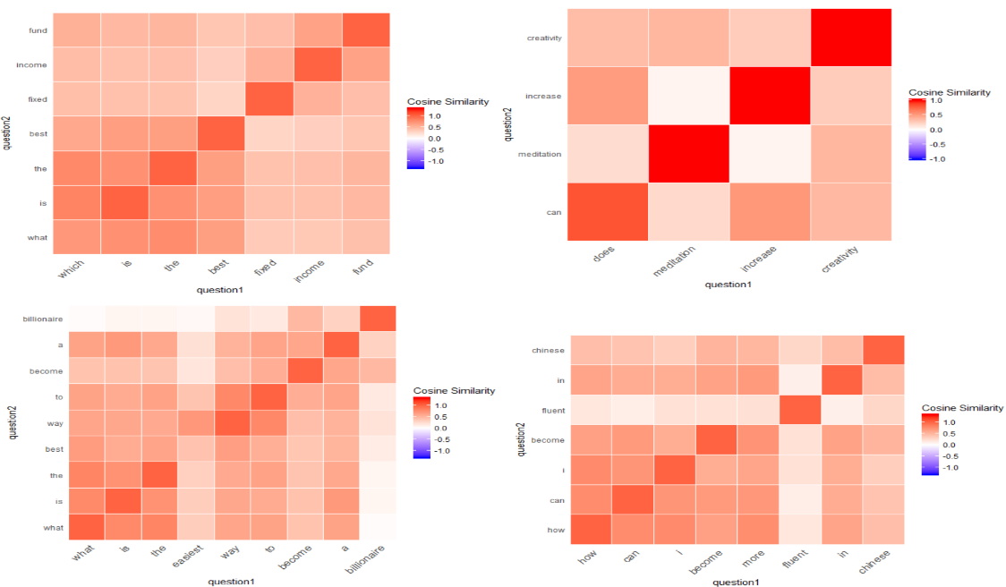
Similarity Matrix:
$Cosine similarity\left(question1,question2\right)=\cos\left(θ\right)=\frac{q1 ∗ q2}{\left\|q1\right\|\left\|q2\right\|}$

Slide 24
Calculate features from similarity matrixes:

Slide 25
Agenda:
Quora challenge
How to proceed?
Data exploration on original data set
Data cleaning
Features engineering and features extraction
Words statistics
Grammatical entities statistics
Grammatical entities and Words sequences
Cosine distances and similarity matrix
Similarity distances using: DTM, TFIDF and LSA
Apply Machine learning models to calculated Features
Deep Learning
Auto-encoders
Classifiers
Demo Shiny application
Notes:
The agenda will be:
I will start by saying something about Quora and its challenge
Then, how to proceed and solve it
I will present some data exploration on the original data set
Then, data cleaning
After, I will talk about features extractions from the sentences of the questions
Features like:
..
I will apply some machine learning models on the calculated features
I will continue with another alternative which does not need to calculated, I will use deep learning using Keras library,
I will not talk about autoencoders which are part of my project,
At the end, if there are remaining time, I will show you a Shiny application where I tried to integrate some parts of the project

Slide 26
Similarity distances using: DTM, TFIDF and LSA:
Matrixes pipelines:
DTM: Document term Matrix
TF-IDF: Term Frequency Inverse Document Frequency
LSA: Latent Semantic Analysis
26

Slide 27
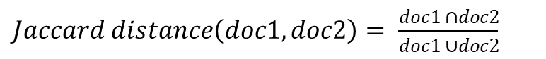
Distances
doc1
doc2
$Jaccard distance\left(doc1,doc2\right)= \frac{doc1 ∩doc2}{doc1 ∪doc2}$
$Cosine similarity\left(doc1,doc2\right)=\cos\left(θ\right)=\frac{doc1 doc2}{\left\|doc1\right\|\left\|doc2\right\|}$
E$uclidean distance= \sqrt{{(x1−x2)}^{2}+ {(y1−y2)}^{2}}$
Relaxed Word Mover's Distance(WMD)
27

Slide 28
Features calculation pipelines:

Slide 29
Agenda:
Quora challenge
How to proceed?
Data exploration on original data set
Data cleaning
Features engineering and features extraction
Words statistics
Grammatical entities statistics
Grammatical entities and Words sequences
Cosine distances and similarity matrix
Similarity distances using: DTM, TFIDF and LSA
Apply Machine learning models to calculated Features
Deep Learning
Auto-encoders
Classifiers
Demo Shiny application
Notes:
The agenda will be:
I will start by saying something about Quora and its challenge
Then, how to proceed and solve it
I will present some data exploration on the original data set
Then, data cleaning
After, I will talk about features extractions from the sentences of the questions
Features like:
..
I will apply some machine learning models on the calculated features
I will continue with another alternative which does not need to calculated, I will use deep learning using Keras library,
I will not talk about autoencoders which are part of my project,
At the end, if there are remaining time, I will show you a Shiny application where I tried to integrate some parts of the project

Slide 30
Merge calculated features

Slide 31
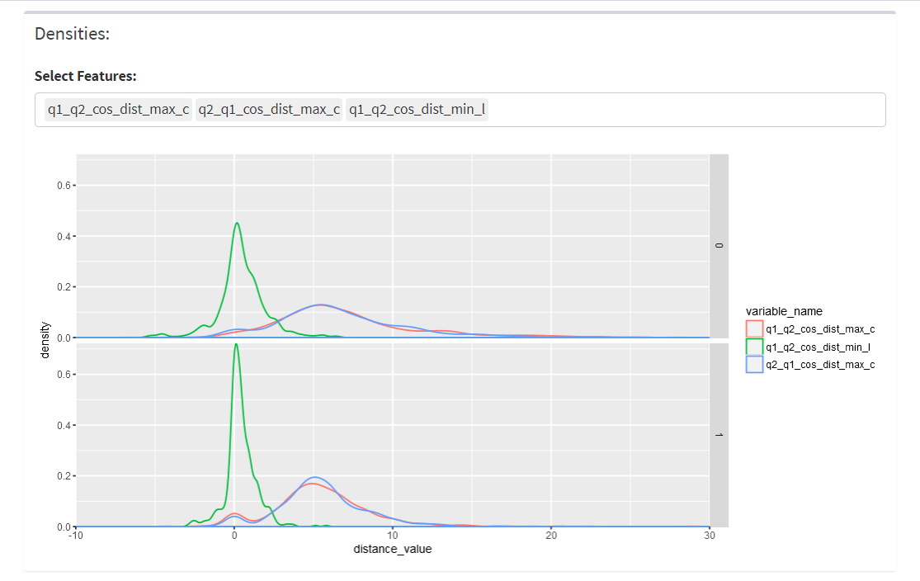
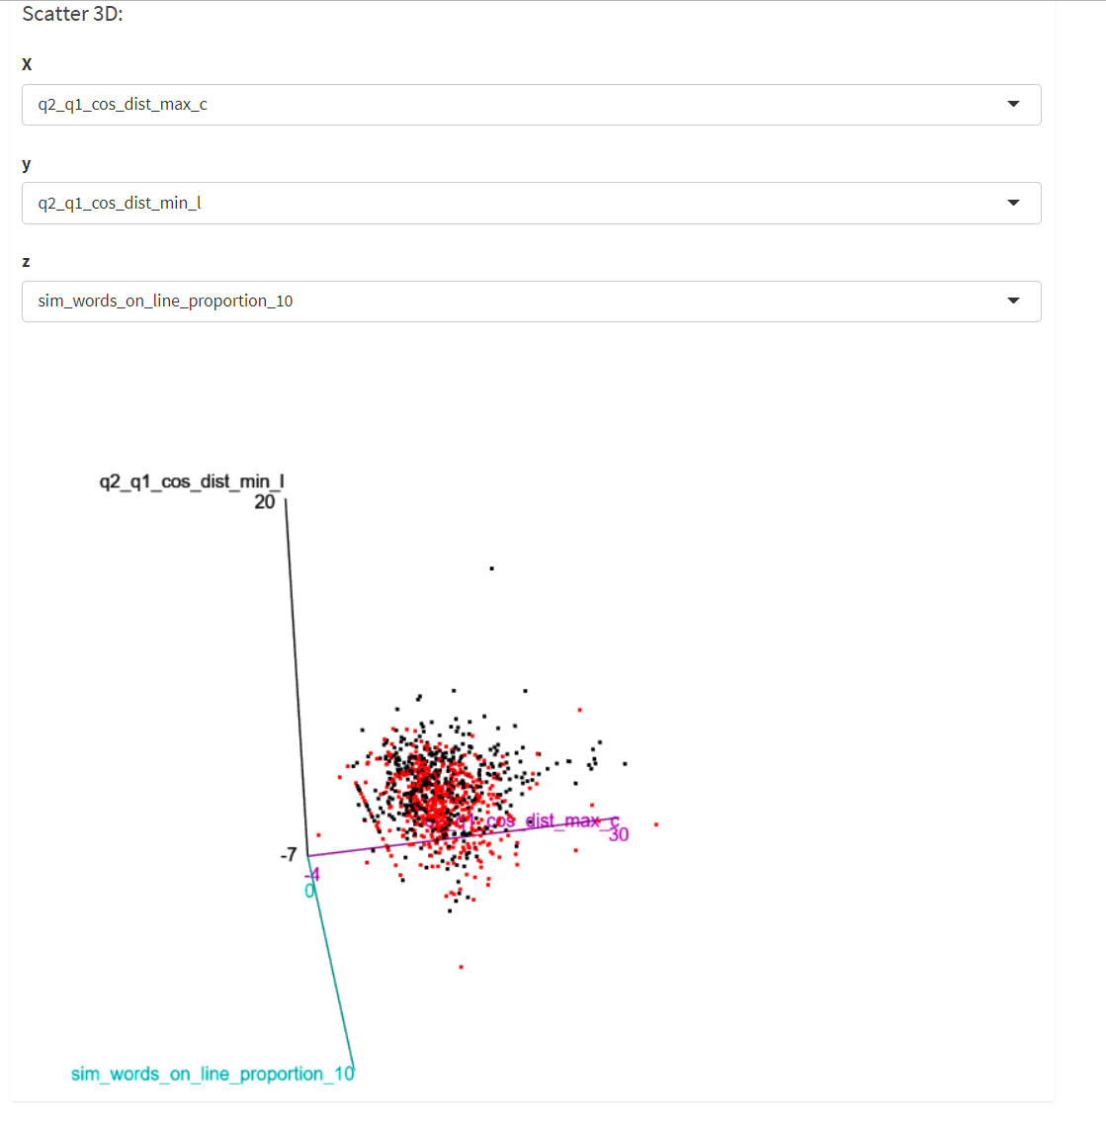
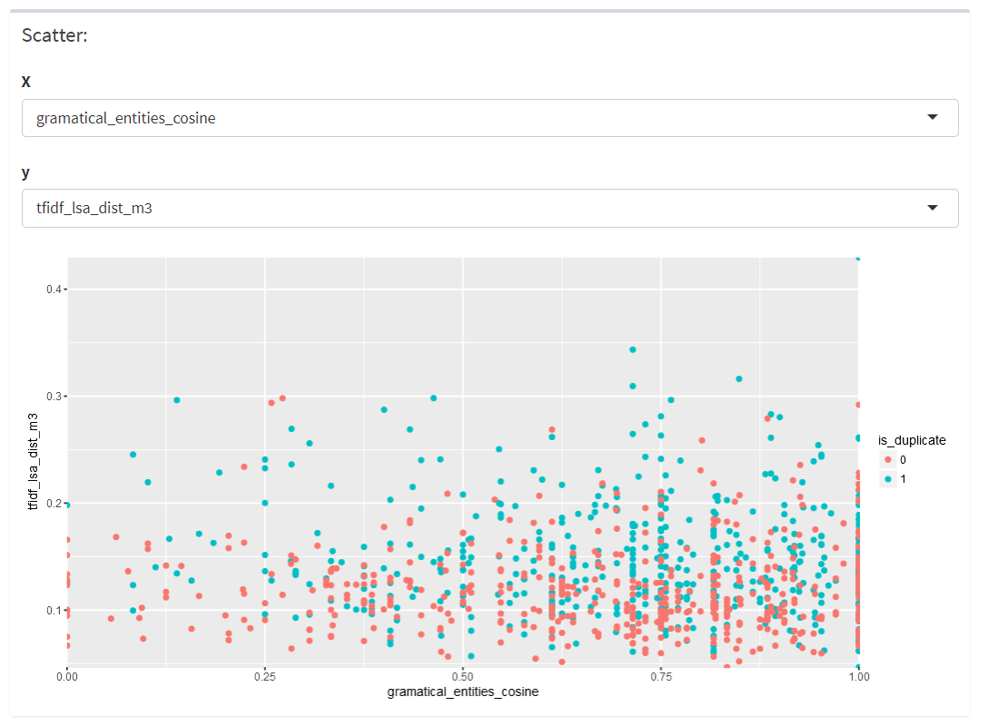
Visualization of features

Slide 32
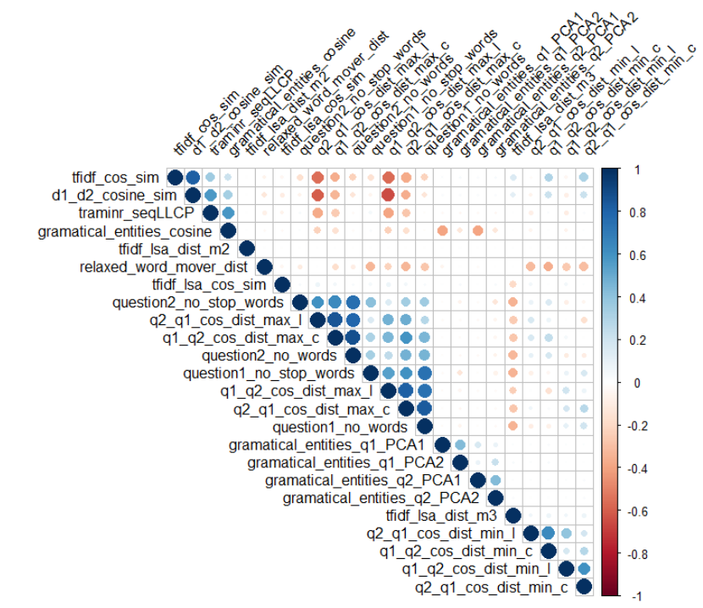
Remove redundancies:
We use corrplot to visualize the correlation between calculated features

Slide 33
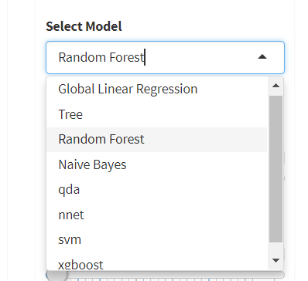
Machine Learning
Different Models:

Slide 34
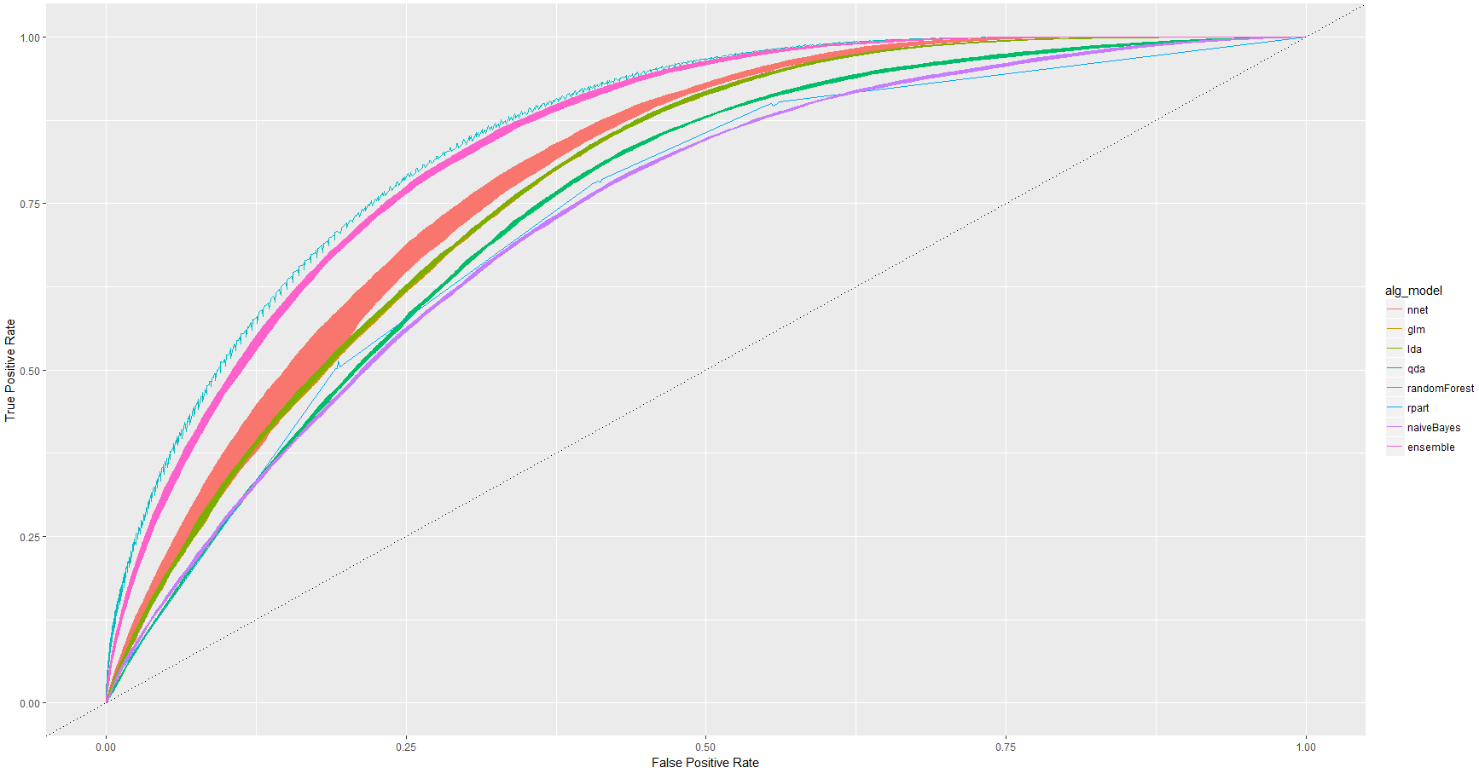
Cross validation K-fold = 5 (ROC Curves)
Random-forest is the best with 78 % accuracy

Slide 35
Agenda:
Quora challenge
How to proceed?
Data exploration on original data set
Data cleaning
Features engineering and features extraction
Words statistics
Grammatical entities statistics
Grammatical entities and Words sequences
Cosine distances and similarity matrix
Similarity distances using: DTM, TFIDF and LSA
Apply Machine learning models to calculated Features
Deep Learning
Auto-encoders
Classifiers
Demo Shiny application
Notes:
The agenda will be:
I will start by saying something about Quora and its challenge
Then, how to proceed and solve it
I will present some data exploration on the original data set
Then, data cleaning
After, I will talk about features extractions from the sentences of the questions
Features like:
..
I will apply some machine learning models on the calculated features
I will continue with another alternative which does not need to calculated, I will use deep learning using Keras library,
I will not talk about autoencoders which are part of my project,
At the end, if there are remaining time, I will show you a Shiny application where I tried to integrate some parts of the project

Slide 36

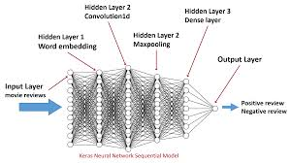
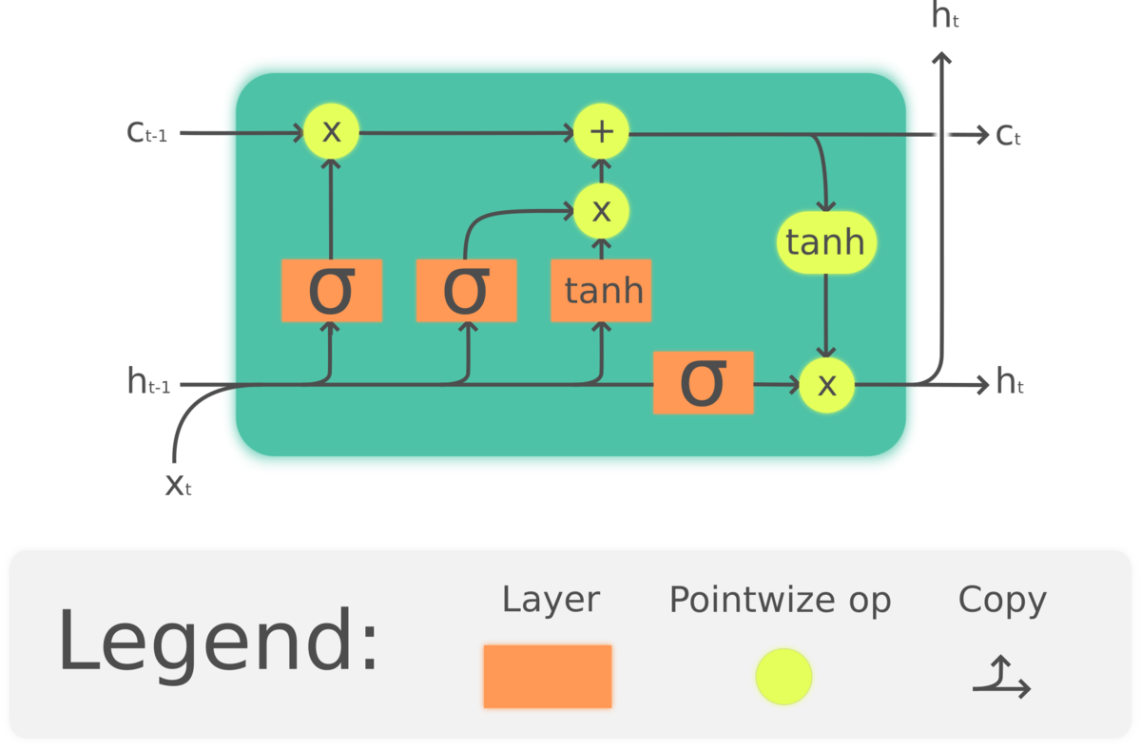
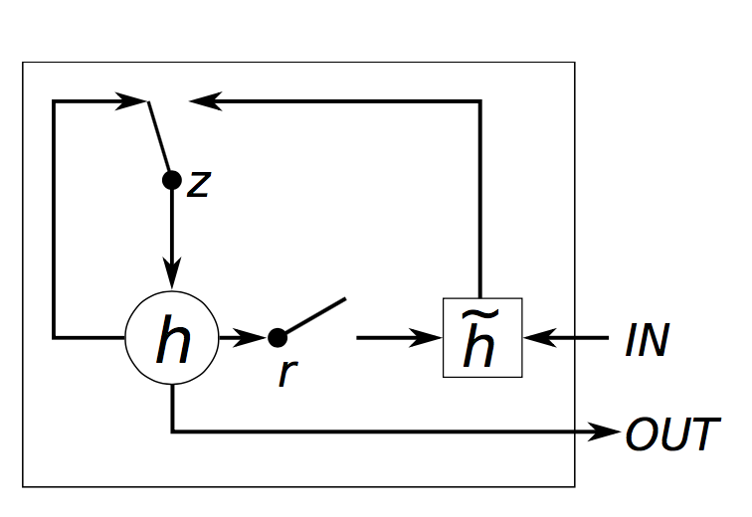
Deep Learning
François Chollet
We used Keras library with backend TensorFlow
Deep Learning Layers:
LSTM, GRU: for word sequences
DOT, Concatenate: Merging two inputs
Dense Layers with activation functions: Relu, Sigmoid
Drop-Out (Overfitting)
Embedding
CNN: Convolution Neural Network

Slide 37
Auto-encoders:

Slide 38
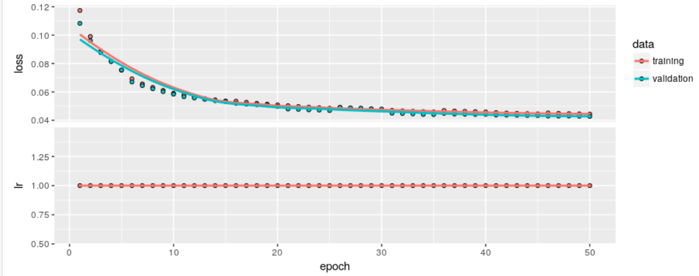
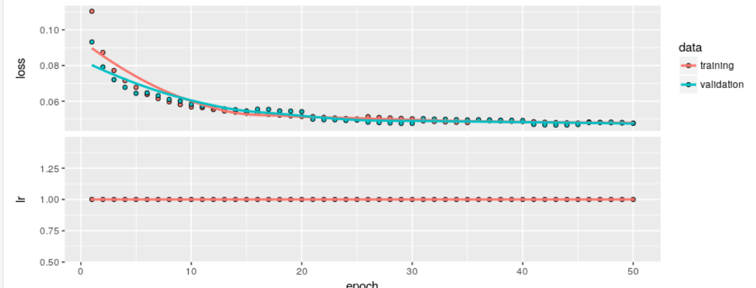
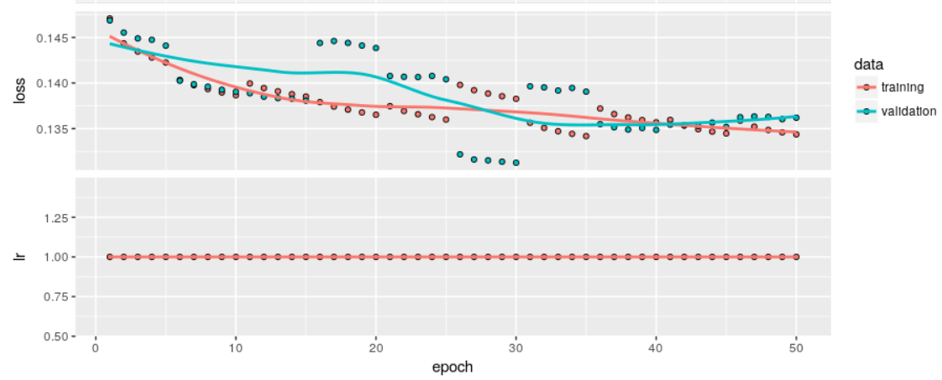
Auto-encoders different models:
38

Slide 39
Deep Learning Classifiers

Slide 40
Deep Learning Classifier Models:

Slide 41
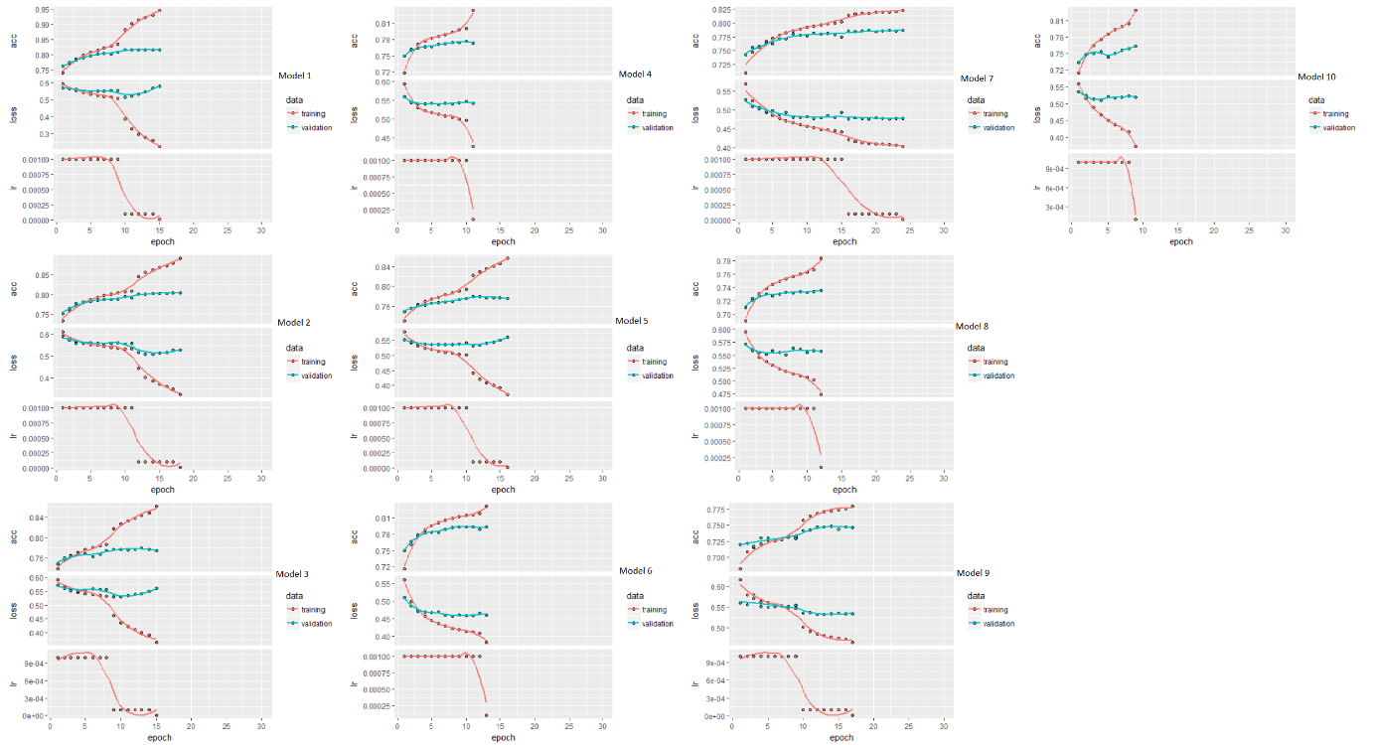
Accuracy and Loss curves of Classifier Models

Slide 42
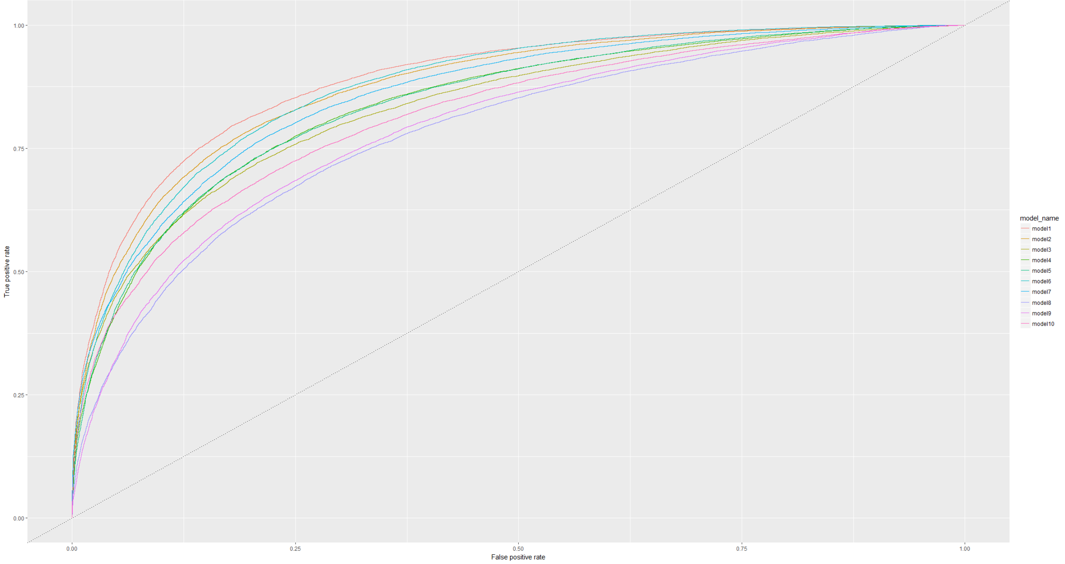
Compare the models with ROC Curves

Slide 43
Shiny Dashboard application:
Demo

Slide 44


Thank You
Abdelhak NEZZARI
abdelhak.nezzari@sap.com

